Slide 1

INT254
Fundamentals of Machine
Learning
Lecture #0
Agenda, Roadmap & Expectations
© LPU :: INT254

Slide 2

Course details
• LTP – 2 0 2
• Credits – 3.0
• Mode – BYOD
• Text Book
–Mathematics for Machine Learning
• ~ A. ALDO FAISAL, CHENG SOON ONG.
Soft Computing using MATLAB
• ~ N.P. PADHY & S. P. SIMON,
© LPU :: INT254

Slide 3
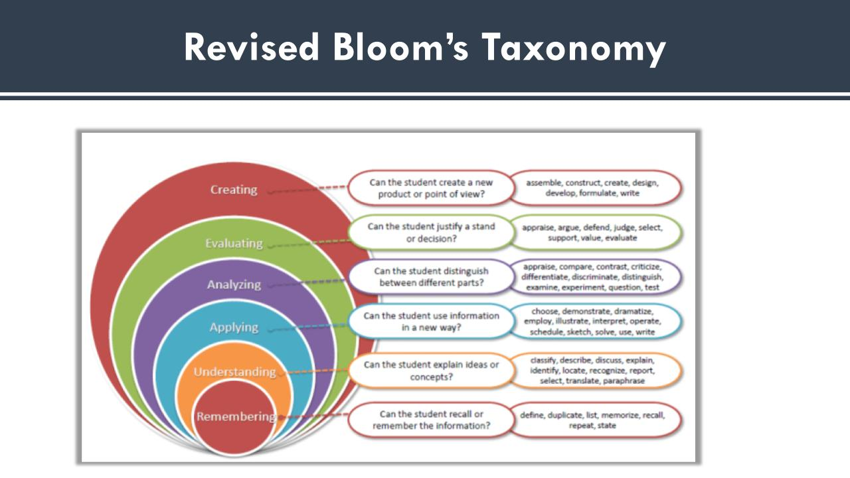

Slide 4
Course Objectives
Define the concepts of linear algebra and multivariate calculus.
Demonstrate the usage of various python libraries for data handling and visualization.
Explain the concepts of dimensionality reduction using PCA.
Make use of fuzzy logic to handle uncertainity in data.
solve the optimization problems using genetic algorithms
Examine the various swarm optimization techniques to solve optimization problems.

Slide 5
Program Outcomes
Engineering knowledge::Apply the knowledge of mathematics, science, engineering fundamentals, and an engineering specialization to the solution of complex engineering problems.
Problem analysis::Identify, formulate, research literature, and analyze complex engineering problems reaching substantiated conclusions using first principles of mathematics, natural sciences, and engineering sciences.
Design/development of solutions::Design solutions for complex engineering problems and design system components or processes that meet the specified needs with appropriate consideration for the public health and safety, and the cultural, societal, and environmental considerations.
Conduct investigations of complex problems::Use research-based knowledge and research methods including design of experiments, analysis and interpretation of data, and synthesis of the information to provide valid conclusions.
Modern tool usage::Create, select, and apply appropriate techniques, resources, and modern engineering and IT tools including prediction and modeling to complex engineering activities with an understanding of the limitations.
The engineer and society::Apply reasoning informed by the contextual knowledge to assess societal, health, safety, legal and cultural issues and the consequent responsibilities relevant to the professional engineering practice.

Slide 6
Cont..
Environment and sustainability::Understand the impact of the professional engineering solutions in societal and environmental contexts, and demonstrate the knowledge of, and need for sustainable development.
Ethics::Apply ethical principles and commit to professional ethics and responsibilities and norms of the engineering practice.
Individual and team work::Function effectively as an individual, and as a member or leader in diverse teams, and in multidisciplinary settings.
Communication::Communicate effectively on complex engineering activities with the engineering community and with society at large, such as, being able to comprehend and write effective reports and design documentation, make effective presentations, and give and receive clear instructions.
Project management and finance::Demonstrate knowledge and understanding of the engineering, management principles and apply the same to one’s own work, as a member or a leader in a team, manage projects efficiently in respective disciplines and multidisciplinary environments after consideration of economic and financial factors.
Life-long learning::Recognize the need for, and have the preparation and ability to engage in independent and life-long learning in the broadest context of technological change.
Competitive Skills::Ability to compete in national and international technical events and building the competitive spirit alongwith having a good digital footprint.

Slide 7
Program Specific Outcomes
Demonstrate understanding of the principles and working of the hardware and software aspects of computer systems by applying knowledge in the areas such as Algorithms, Software Engineering, Networking & Security, Database Management Systems, Intelligent Systems, Operating Systems and System Architecture.
Use professional engineering practices, strategies and tactics to attain the ability to design, develop and maintain software based products and services, evaluate and recognize potential risks, provide creative, economical and optimal computing solutions.
Acquaint with the contemporary trends in industrial/research settings and thereby innovate efficient novel real time solutions to existing problems in inter-disciplinary domains for societal benefits through projects.
Ability to adapt to future technologies through acquired skills and knowledge to ideate, design, test and deploy computationally intensive applications or solutions for different business environments.

Slide 8

Course Assessment Model
• Marks break up*
• Attendance
• CA
5
25
–Project
–1 Best out of 2 Code based Test
• MTT
• ETT
20
50
• Total
100
© LPU :: INT254

Slide 9
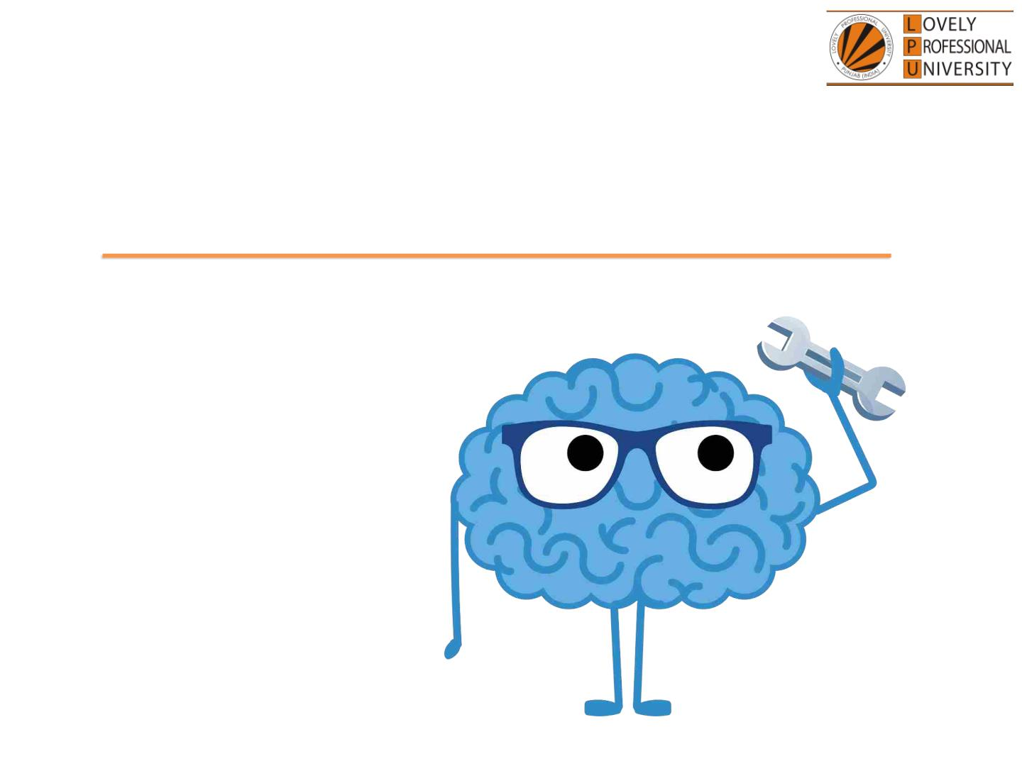
Machine Learning
© LPU :: INT254

Slide 10
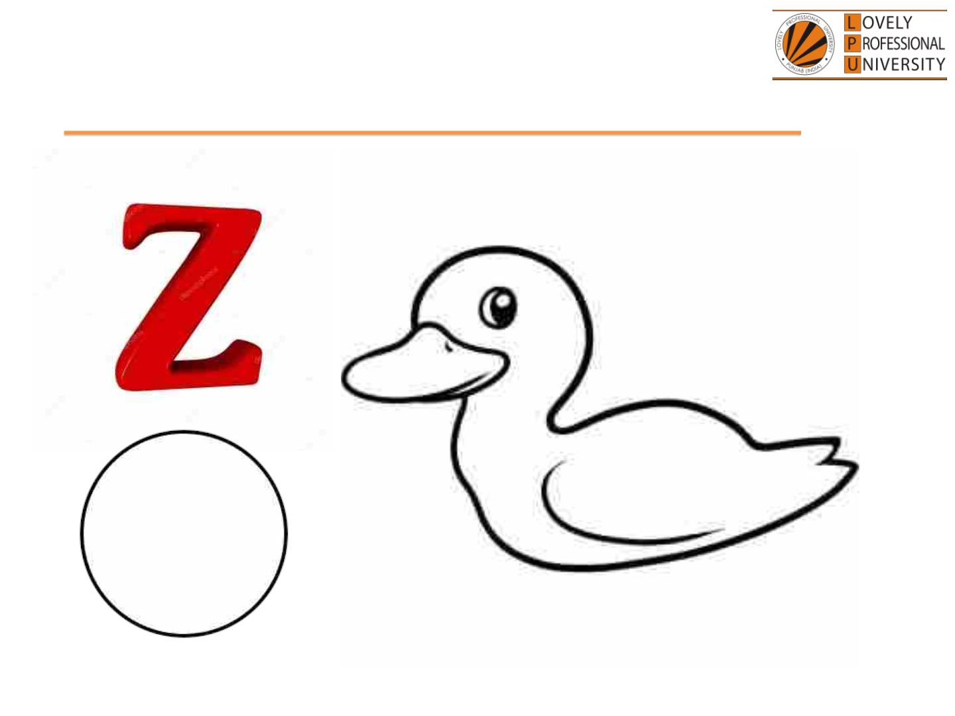
Learning – Aspect #1
© LPU :: INT254

Slide 11

Discrete/Labeled dataset
• You used prior learnings of -
• Shapes
• Patterns
• Categories
• Weighed them to MOST nearing
entity
• And finally classified it into
ANSWER!!!
© LPU :: INT254

Slide 12

What is Machine Learning
• Machine learning, the application and science of
algorithms that makes sense of data, using self
learning Algorithms we can turn data into
knowledge.
• When most people hear “Machine Learning” they
picture a robot depending on who you ask
i.e. Optical Character Recognition
© LPU :: INT254

Slide 13
Cont.
• Machine Learning is the science of programming
computers so they can learn from data.
For example, your spam filter is a Machine
Learning program that can learn to flag spam/Ham.
© LPU :: INT254

Slide 14
Use of Machine Learning
•First you would look at what spam typically looks
like. You might notice that some words or phrases
(such as “Lottery,” “credit card,” “free,”) tend to
come up a lot in the subject. Perhaps you would
also notice a few other patterns in the sender’s
name and so on.
•You would write a algorithm for each of the
patterns, and your program would flag emails as
spam if a number of these patterns are detected.
© LPU :: INT254

Slide 15
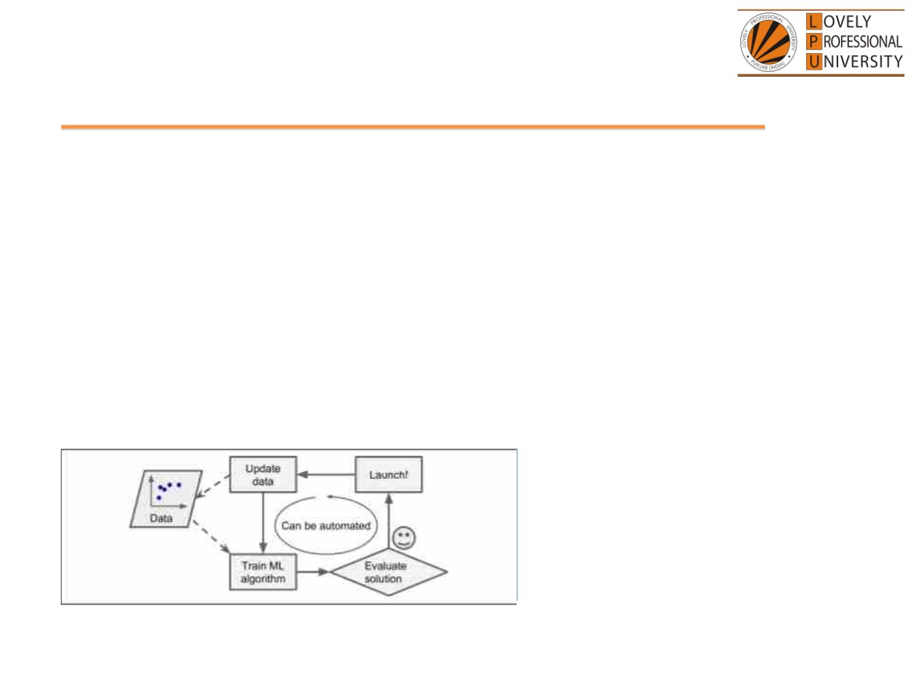
Cont.
• Moreover, if spammers notice that all their
emails containing “4U” are blocked, they might
start writing “For U” instead. A spam filter using
traditional programming techniques would need to
be updated to flag “For U” emails.
Fig:- Automatically adapting to change
© LPU :: INT254

Slide 16
Types of Machine Learning
• There are so many different types of Machine
Learning systems that it is useful to classify them in
broad categories based on:
• Supervised Learning
• Unsupervised Learning
• Reinforcement Learning
© LPU :: INT254

Slide 17
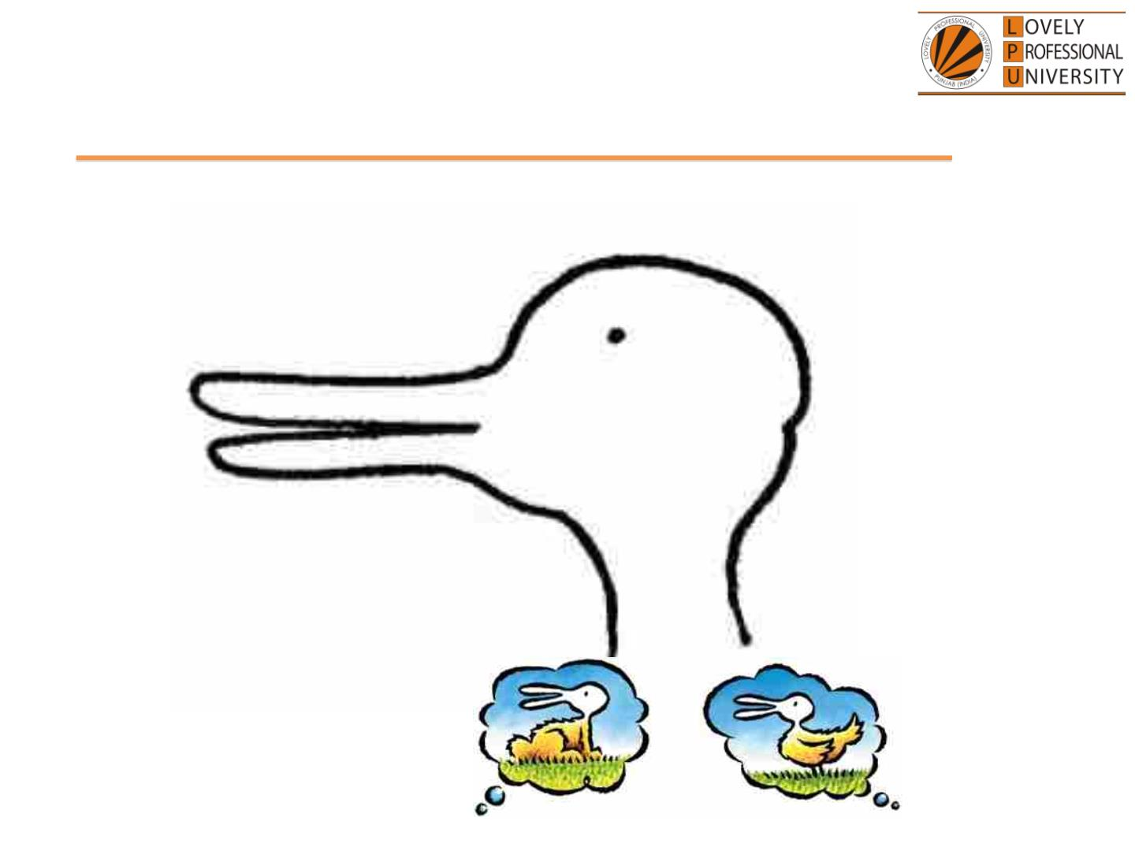
Aspect #1 Challenge
© LPU :: INT254

Slide 18
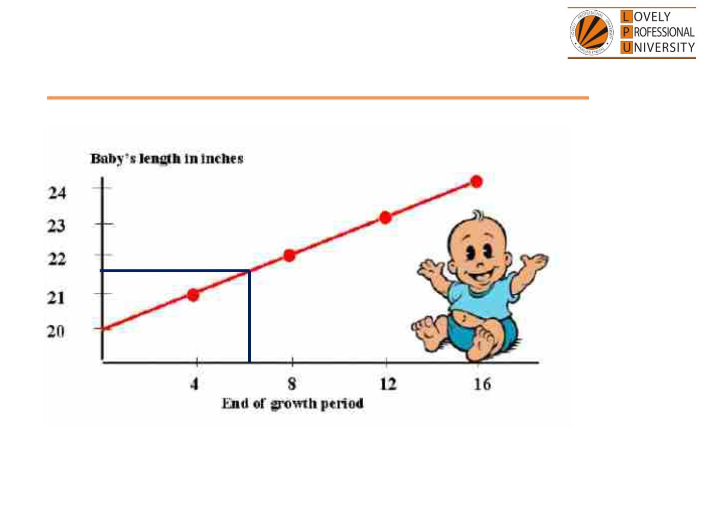
Learning – Aspect #2
© LPU :: INT254

Slide 19
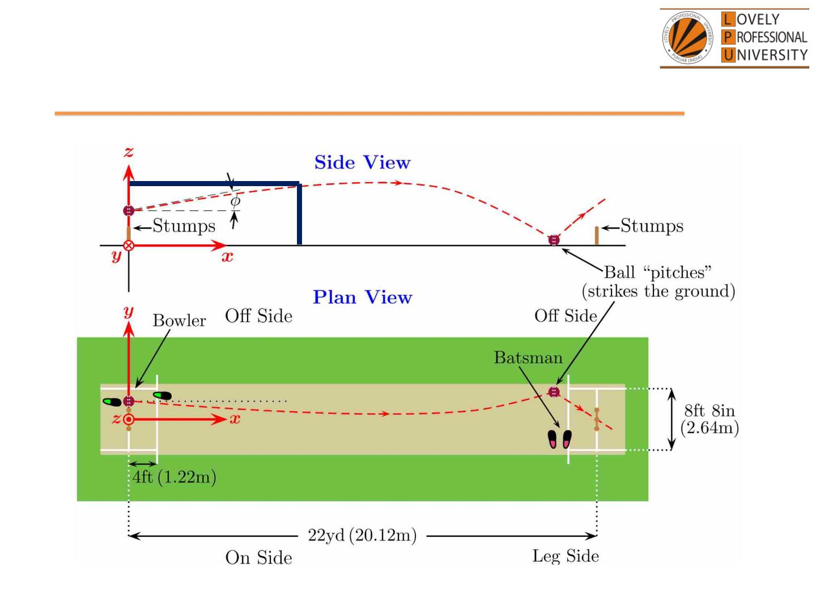
Learning – Aspect #2
© LPU :: INT254

Slide 20
Continuous dataset
• You used prior learnings of -
• Variability
• Coordinate geometry
• X – Y correlation
• Plot reading
• And finally build the ANSWER!!!
© LPU :: INT254

Slide 21
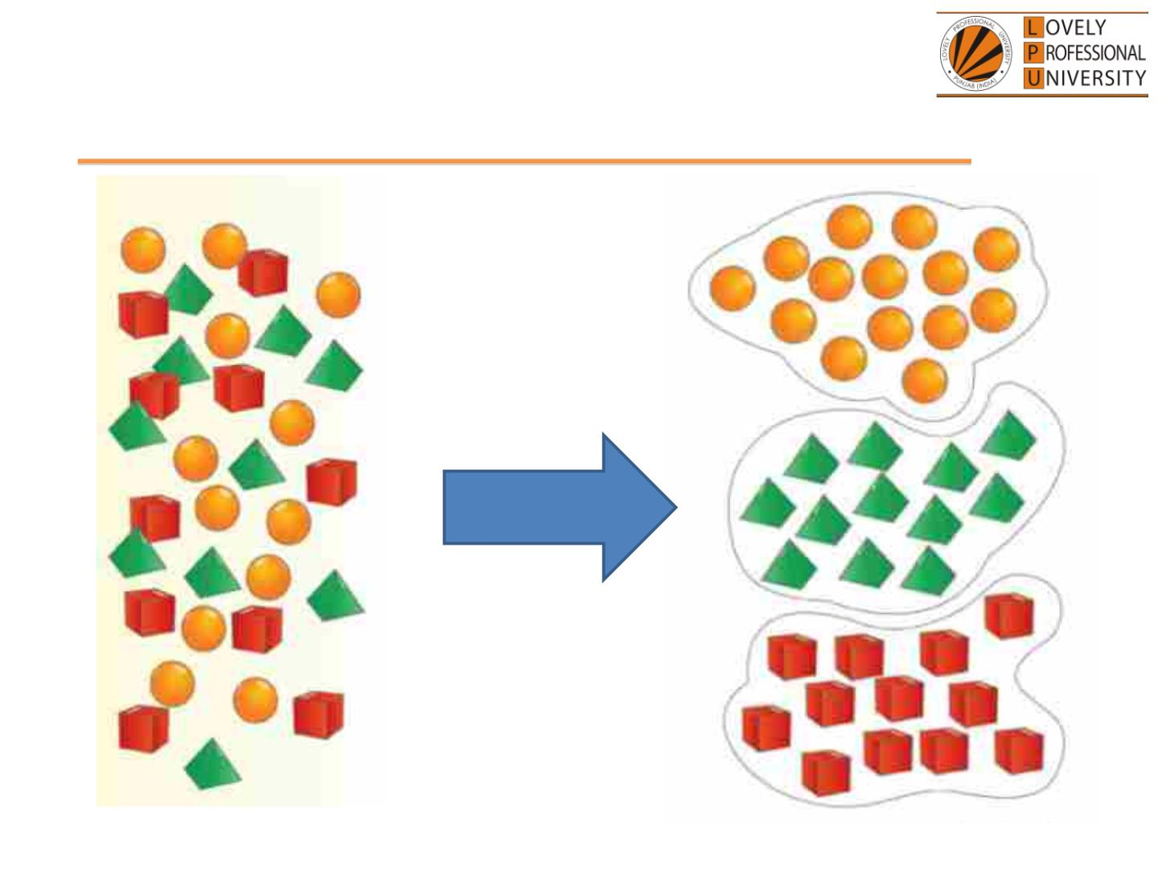
Learning – Aspect #3
© LPU :: INT254

Slide 22
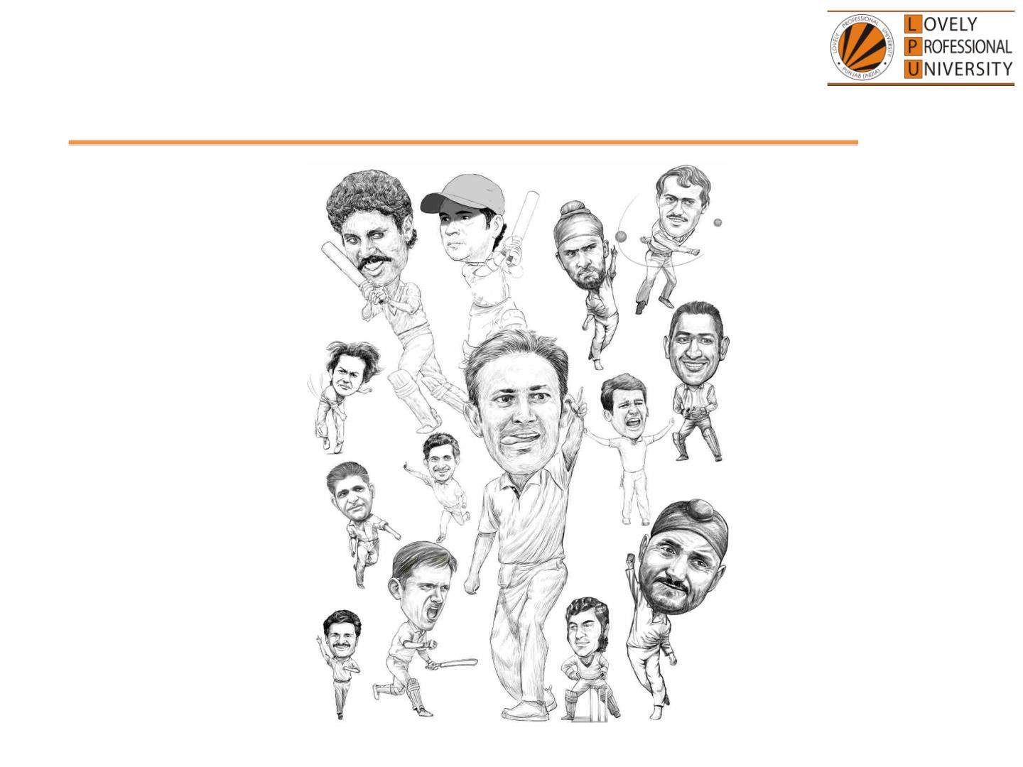
Learning – Aspect #3
© LPU :: INT254

Slide 23
Unknown dataset
• You used prior learnings of -
• Grouping objects
• Extracting meaningfulness
• Associating conjectures
• And finally build the Clusters!!!
© LPU :: INT254

Slide 24
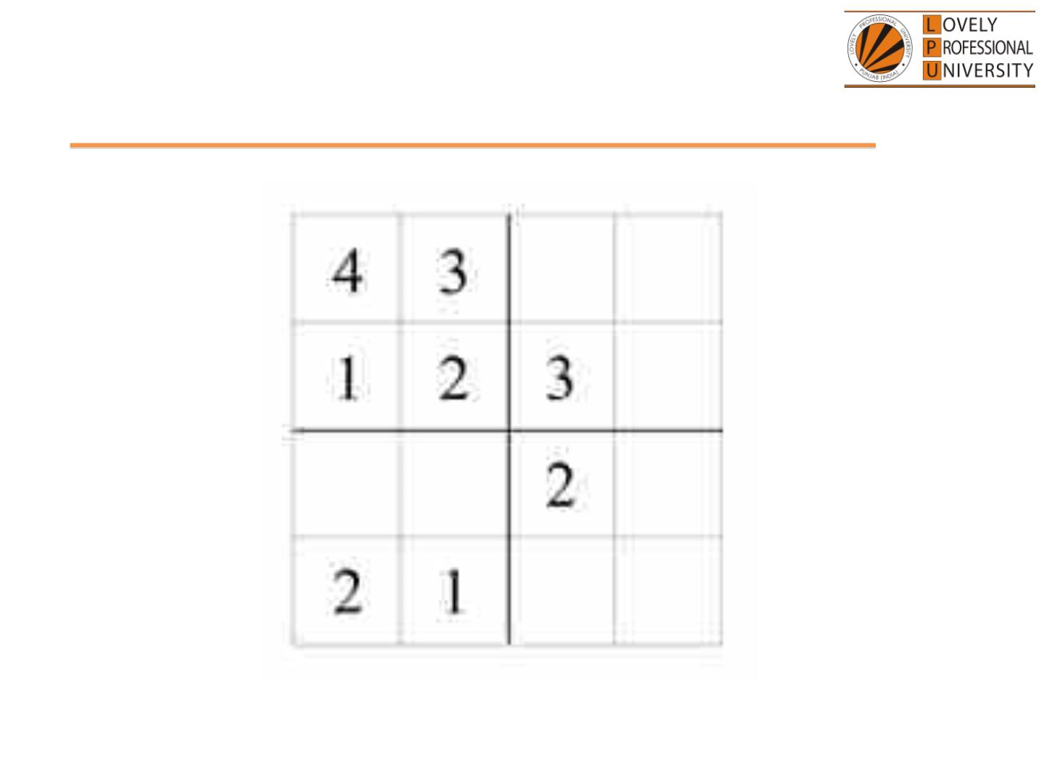
Learning – Aspect #4
© LPU :: INT254

Slide 25
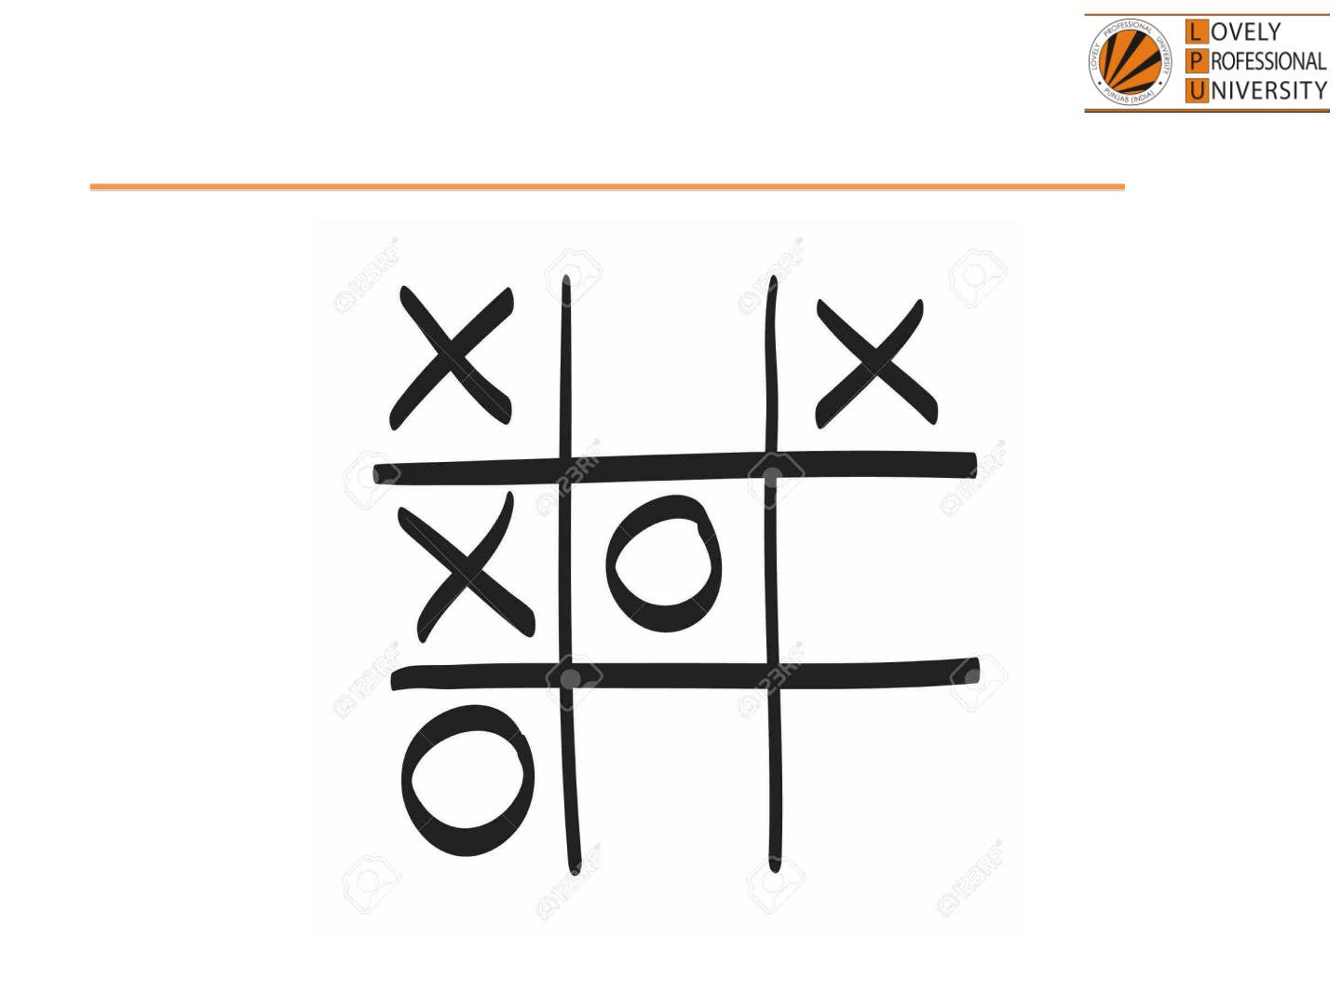
Learning – Aspect #4
© LPU :: INT254

Slide 26
Iterative revisit
• You played keeping
• NEXT MOVE(s)
• Probability of losing with a said
move
• Back tracking earlier opponent
moves
• And finally moved!!!
© LPU :: INT254

Slide 27
Aspect summary
• #1 and #2
• Prior information available to build
answers
• #3
• Meaningful grouping of unknown and
cluttered data
• #4
• Reiteration and loop back on pre and
post information
© LPU :: INT254

Slide 28
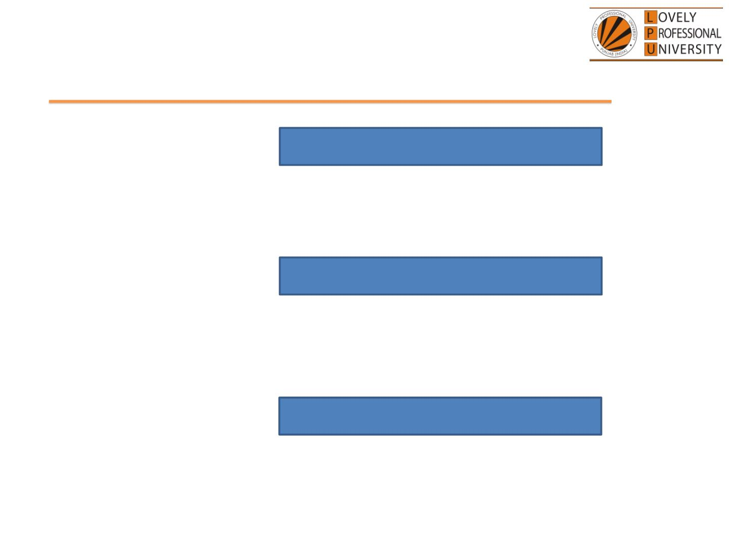
Aspect summary
• #1 and #2
Supervised
• Prior information available to build
answers
• #3
Unsupervised
• Meaningful grouping of unknown and
cluttered data
• #4
Reinforcement
• Reiteration and loop back on pre and
post information
© LPU :: INT254

Slide 29
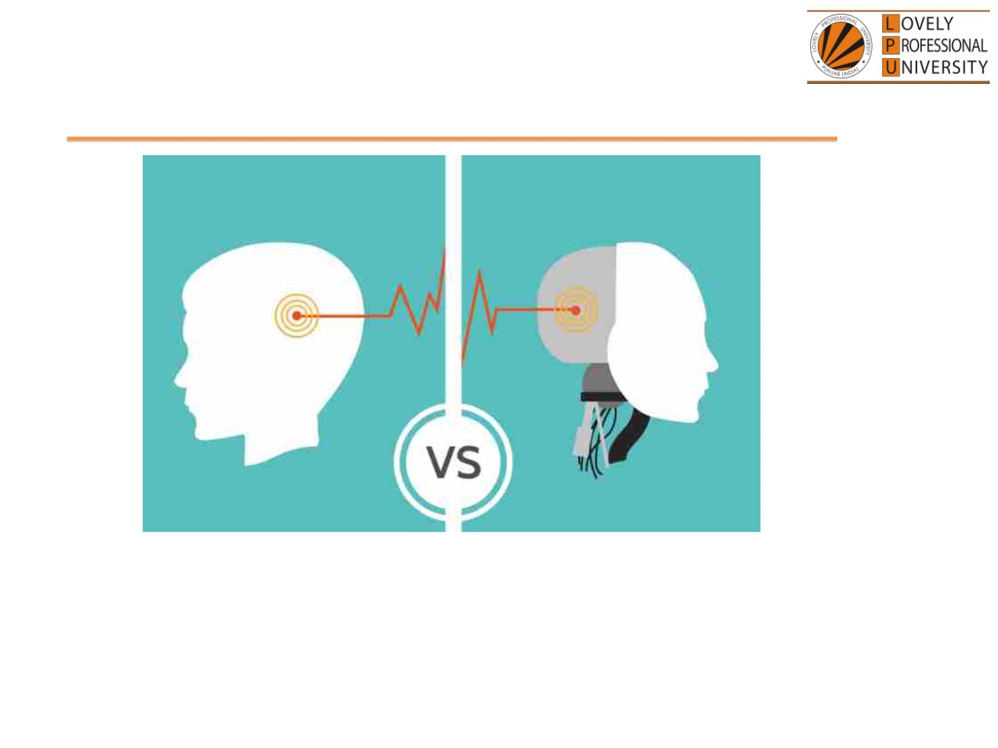
Human v/s Computers
• Everything is a
PATTERN
• Natural ability to
learn, unlearn and
relearn
• Everything is DATA
• Will need code to
understand data,
visualize data and
extract meaning
© LPU :: INT254

Slide 30
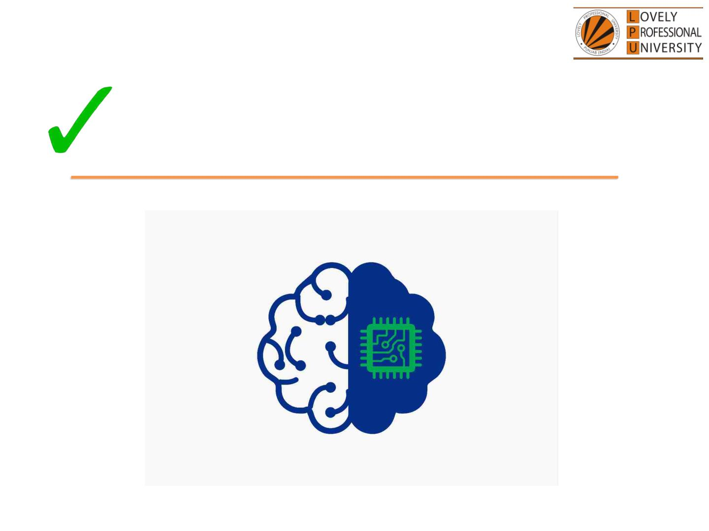
Machine Learning
© LPU :: INT254

Slide 31
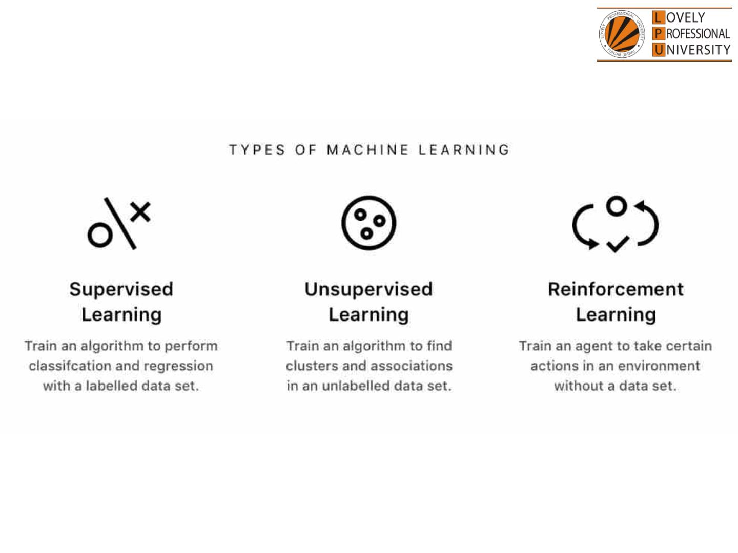
© LPU :: INT254

Slide 32
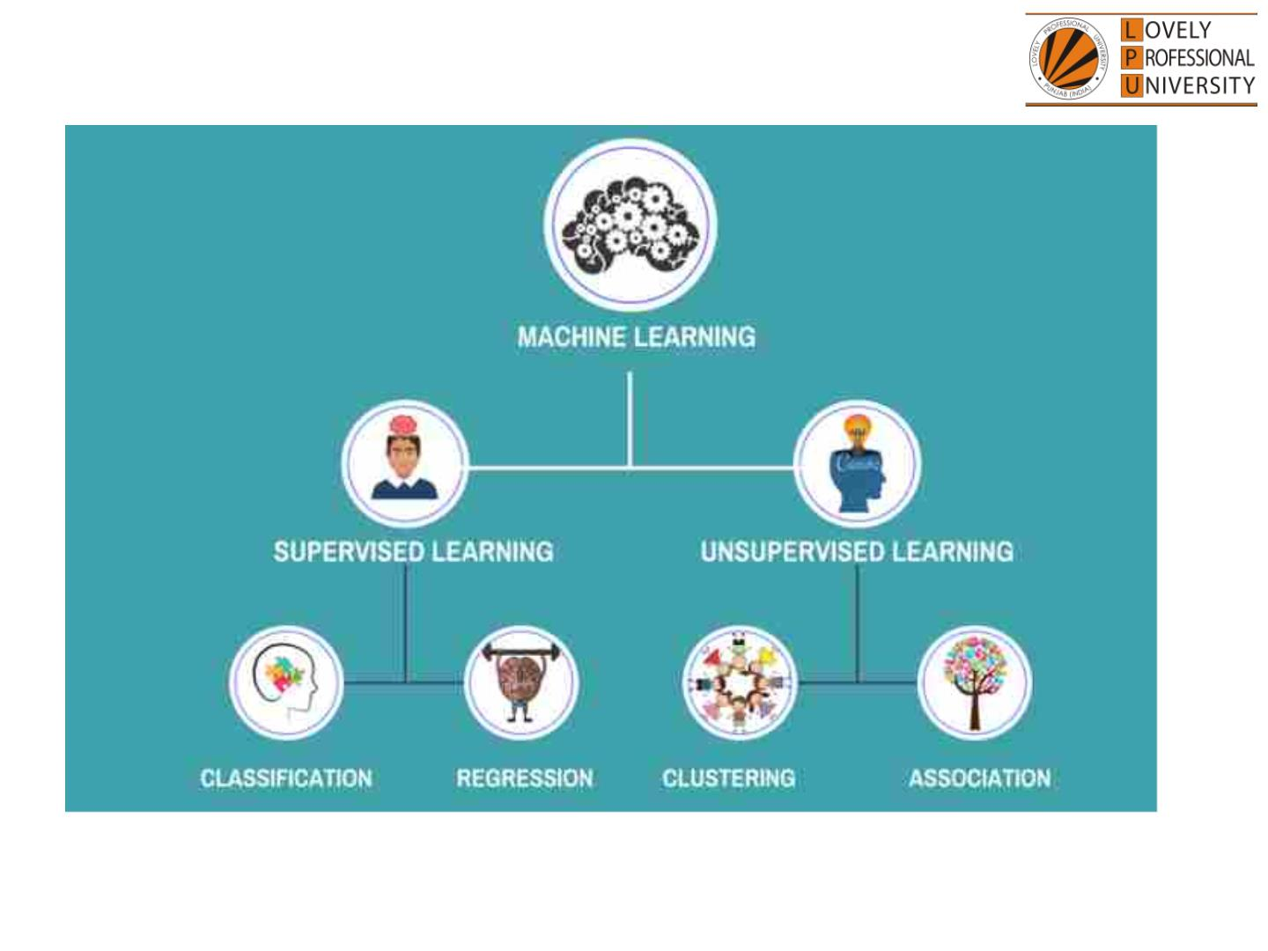
© LPU :: INT254

Slide 33

The course contents
Linear algebra : Introduction to linear algebra, operations with vectors, modulus and inner product,
cosine and dot product, projection, changing basis, matrices, solving simultaneous equation problems,
types of matrix transformation, determinants and inverses, matrices changing basis, orthogonal
matrices, eigen values and eigen vectors
Multivariate calculus : Introduction to multivariate calculus, definition of a derivative, differentiation
examples & special cases,, product rule, chain rule, differentiate with respect to anything, The
Jacobian, The Hessian, multivariate chain rule, building approximate functions, power series,
linearisation, multivariate taylor
Data handling and visualization using python : types of data, reading the data, math operations
for data analysis, handling missing values, Converting data into numerical format, correlation matrix,
data visualization using different graphs
Dimensionality Reduction : statistics of dataset, orthogonal projections, problem setting and PCA
objective, finding the coordinates of the projected data, steps of PCA, linear discriminant analysis,
kernel PCA
© LPU :: INT254

Slide 34
The course contents
Fuzzy logic : basic definition and terminology, set-theoretic fuzzy operations, fuzzy sets and
operations on fuzzy sets, fuzzy relations, fuzzy rules and fuzzy reasoning, fuzzy inference system,
fuzzification and defuzzification methods, fuzzy based expert system
Genetic algorithms : introduction to genetic algorithms, genetic operators, working of genetic
algorithm, applications of genetic algorithm, genetic programming
Swarm optimization techniques : swarm intelligence, ant colony optimization, swarm intelligence
in bees, cuckoo search, Firefly Algorithm, Crow Search Algorithm, Hybrid Wolf-Bat Algorithm, Whale
Search Algorithm, grasshopper optimization
© LPU :: INT254

Slide 35
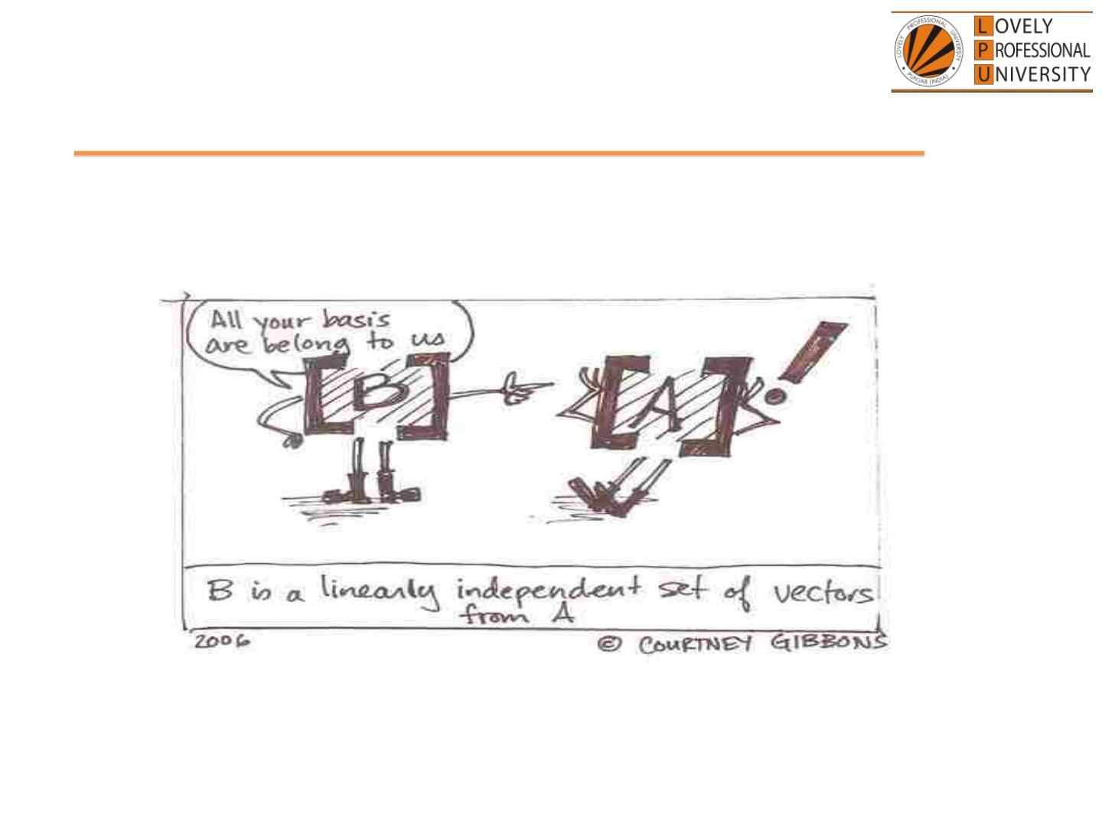
Linear Algebra
© LPU :: INT254

Slide 36
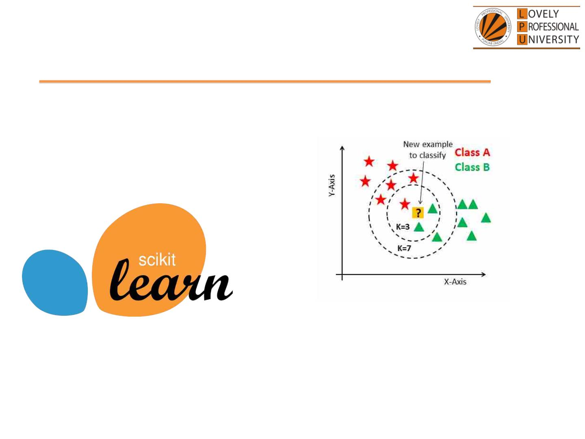
Data handling and visualization
Pandas,Numpy and Matplot Libraries
© LPU :: INT254

Slide 37
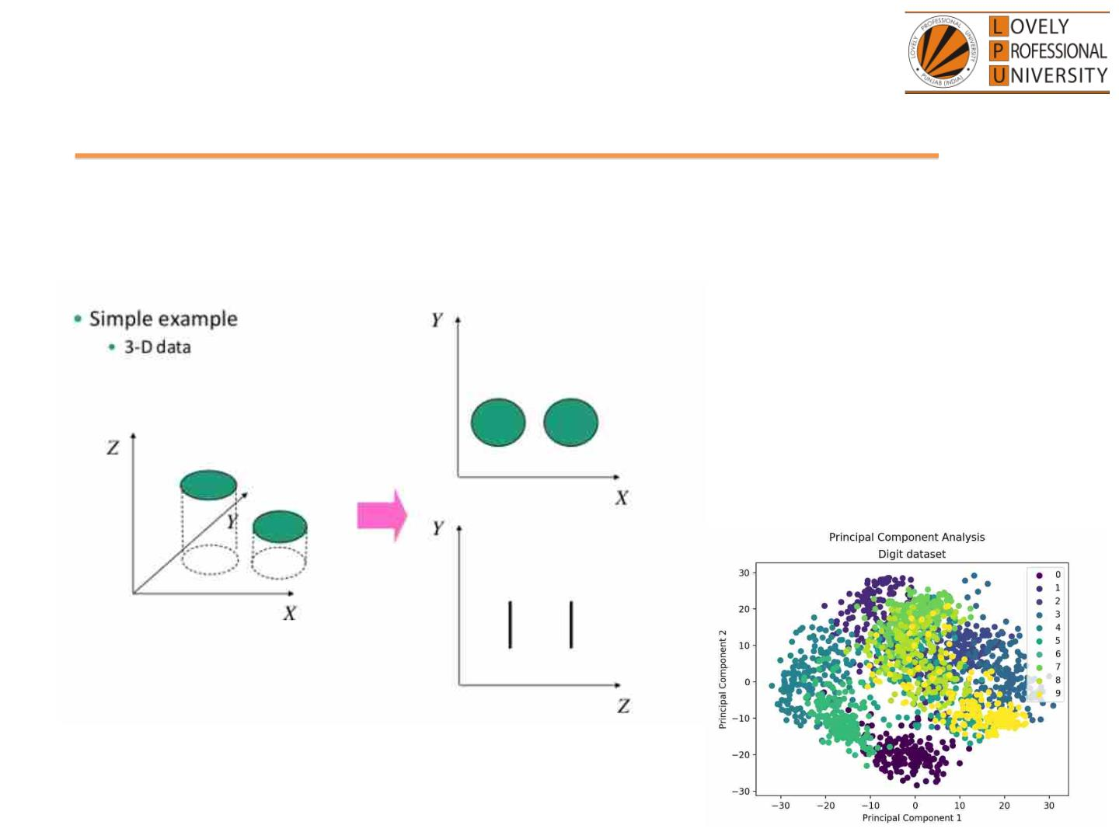
Dimension Reduction
Principle Component Analysis
© LPU :: INT254

Slide 38
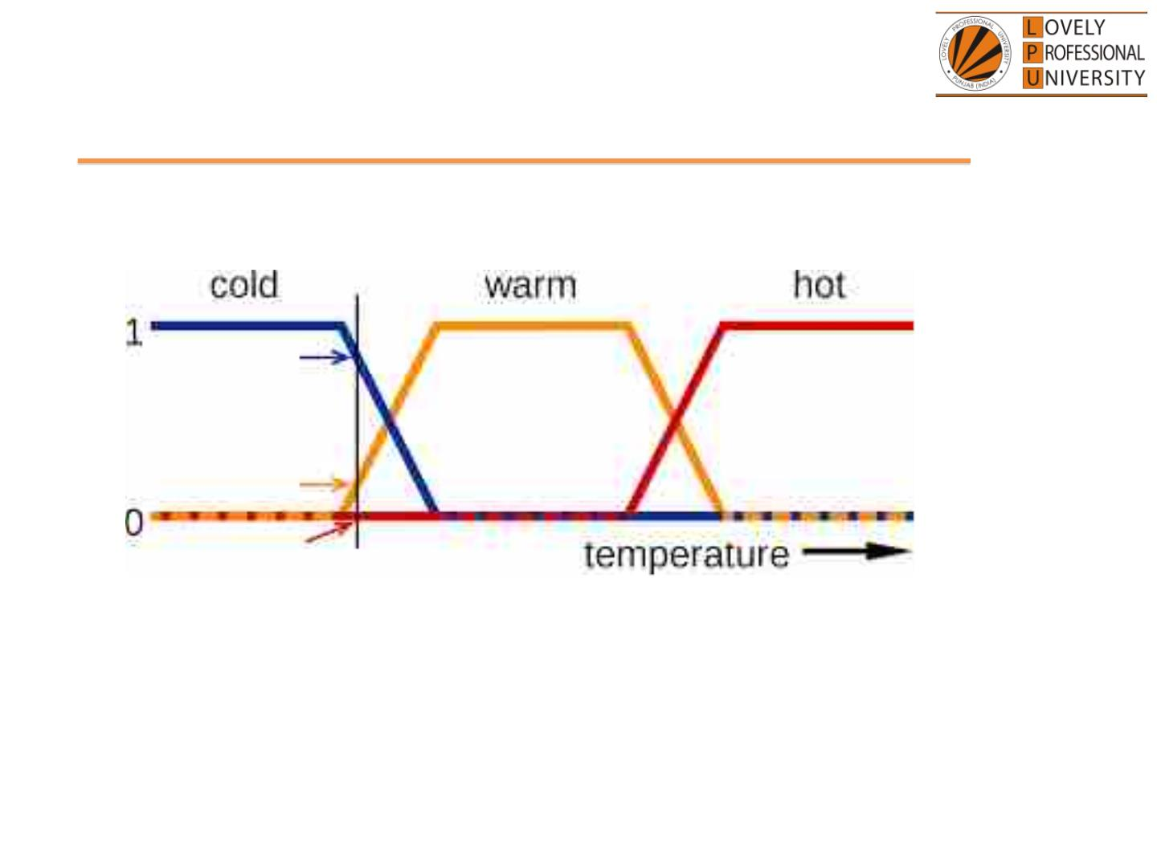
Fuzzy Logic
© LPU :: INT254

Slide 39
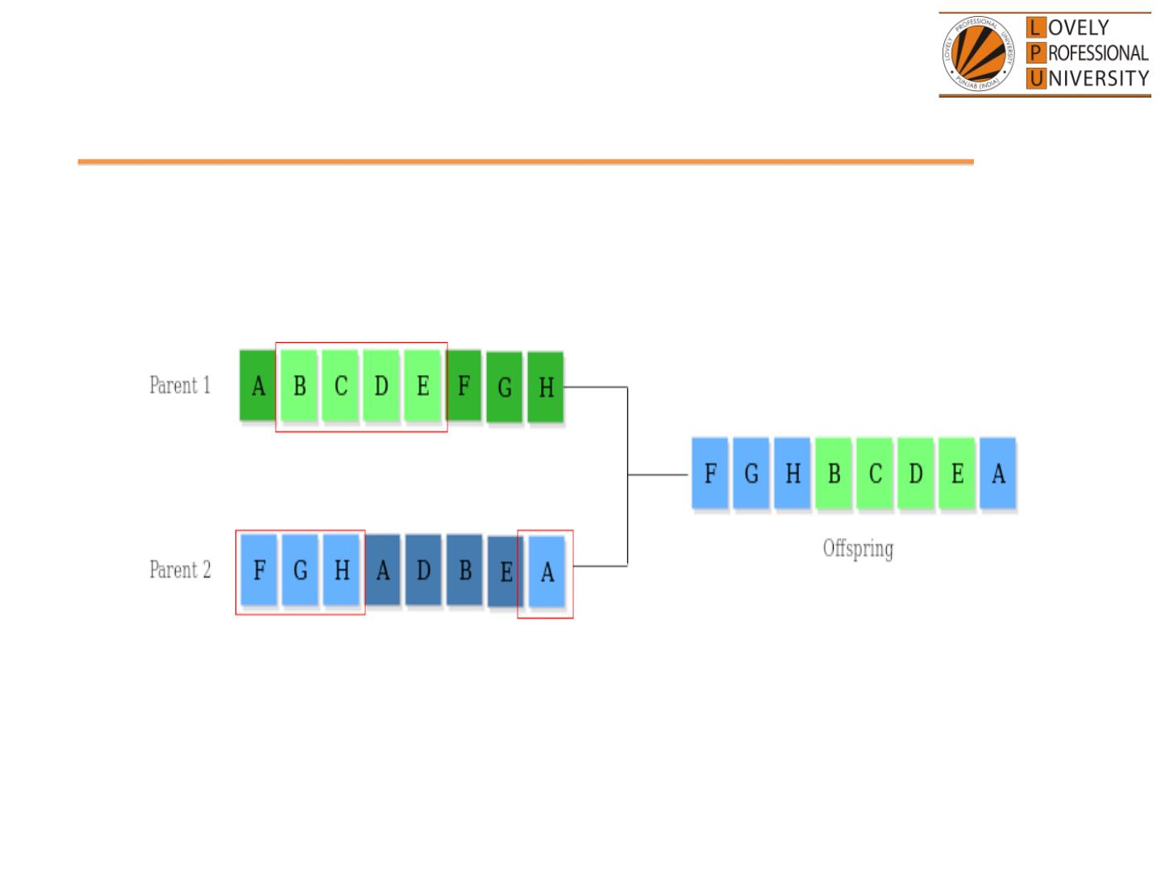
Genetic Algorithms
© LPU :: INT254

Slide 40
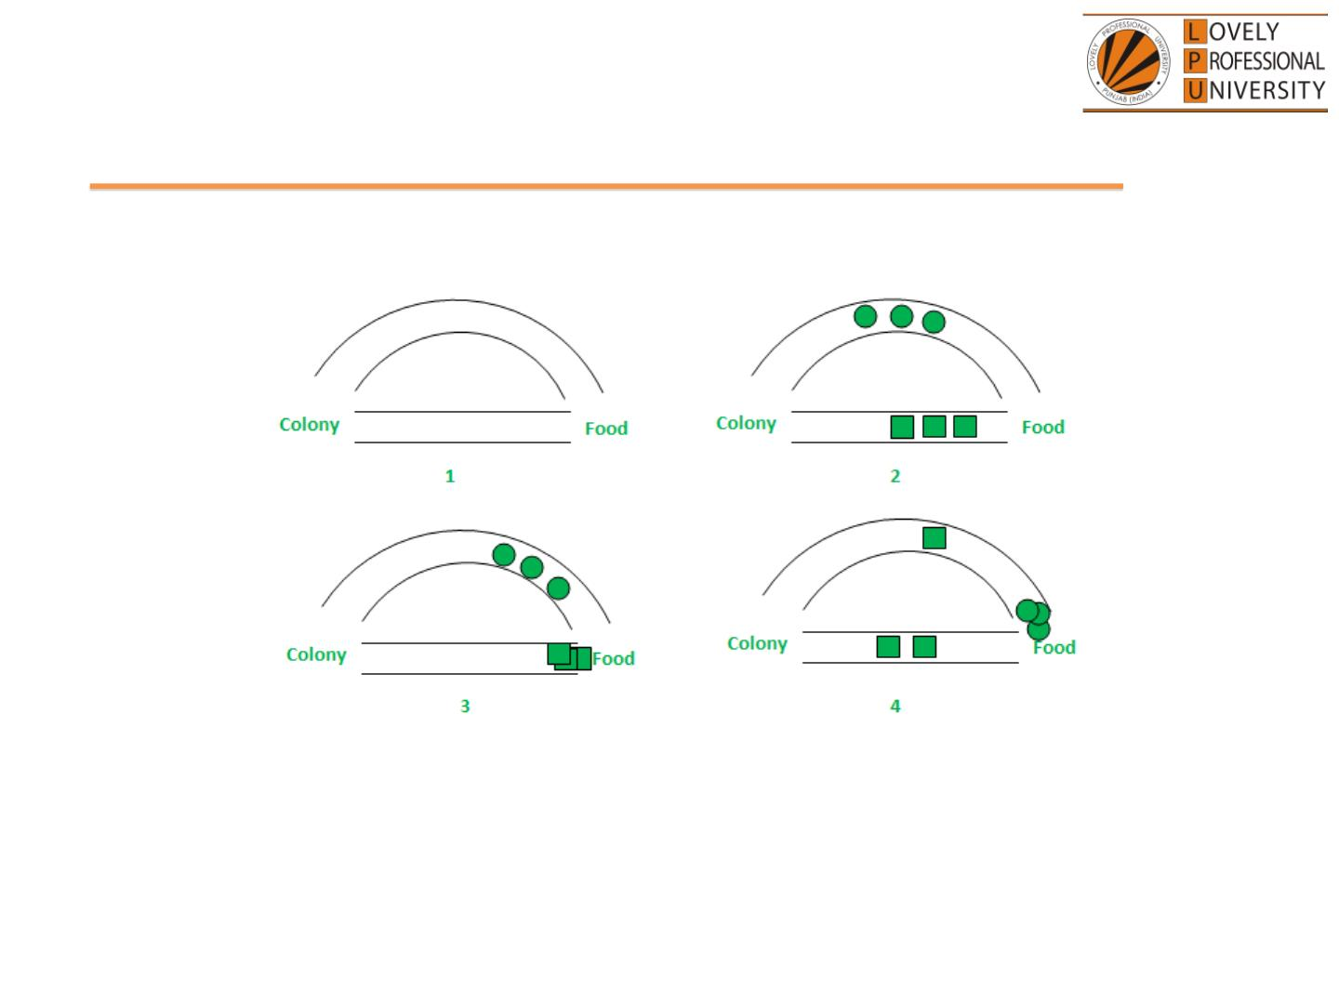
Swarm optimization Techniques
© LPU :: INT254

Slide 41
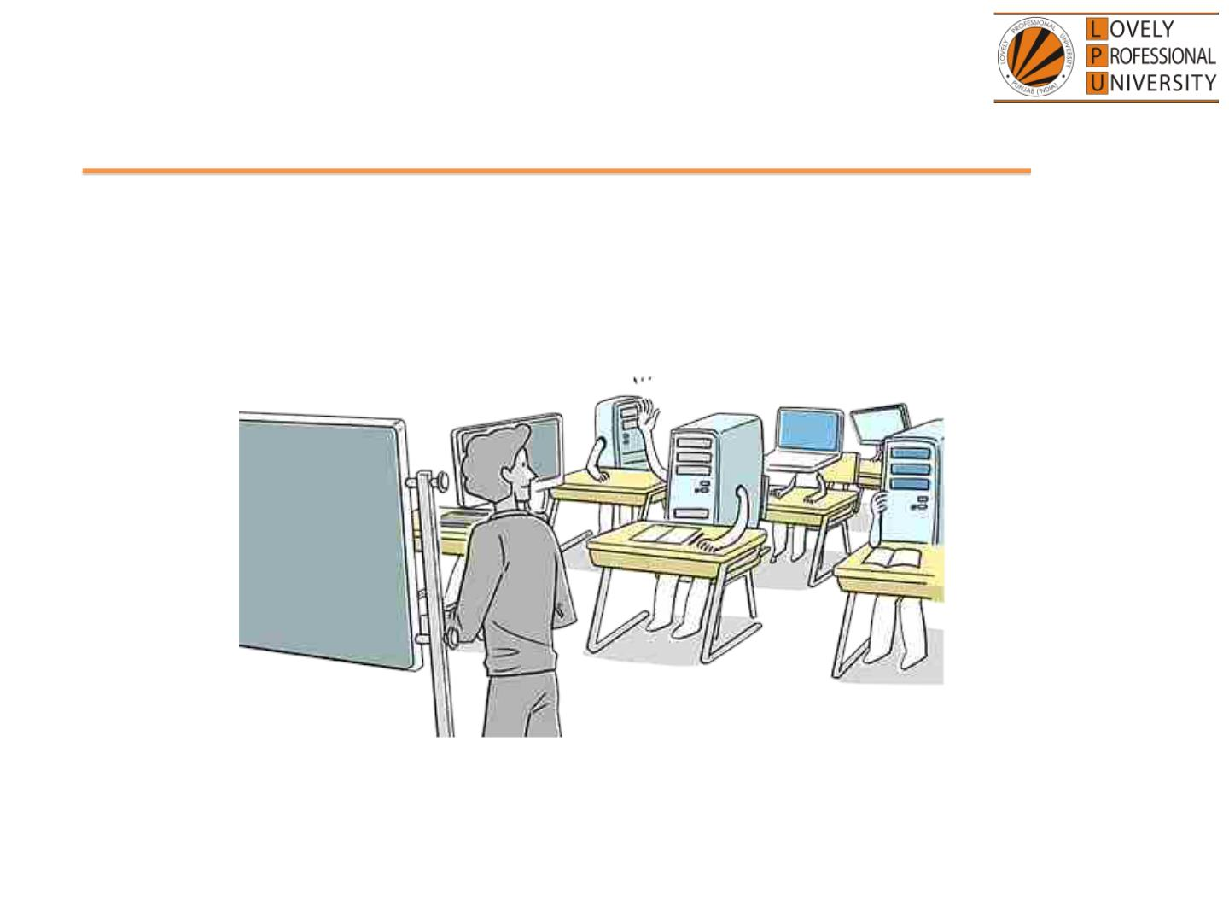
Get Set Go!!!
Get trained to TRAIN systems…
Build futuristic solutions…
© LPU :: INT254

Slide 42

Assessment expectations & example
© LPU :: INT254

